Slide 1
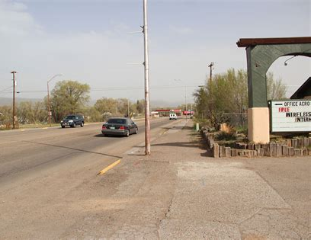
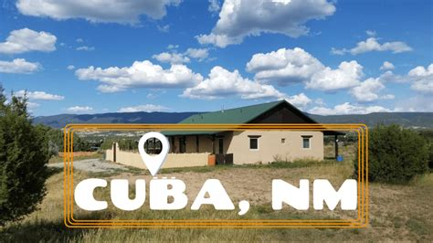
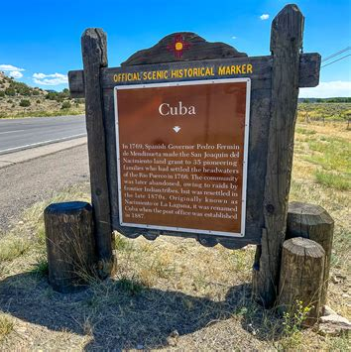
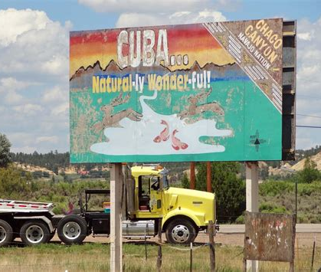
Enhancing Community Safety: An Analysis of Security and Violence in Cuba, New Mexico
Engineering Business & Society ENG-220-001
Ramiro Jordan
Pavithra Ravipati
Nitheesha Racha
Oreoluwa Sanya
Team 2
  Max Brewer (PM) | Rachael Stokes | Sierra Tsosie | Janet Ziglar | Adam Branchal | Brooke Morenus

Slide 2
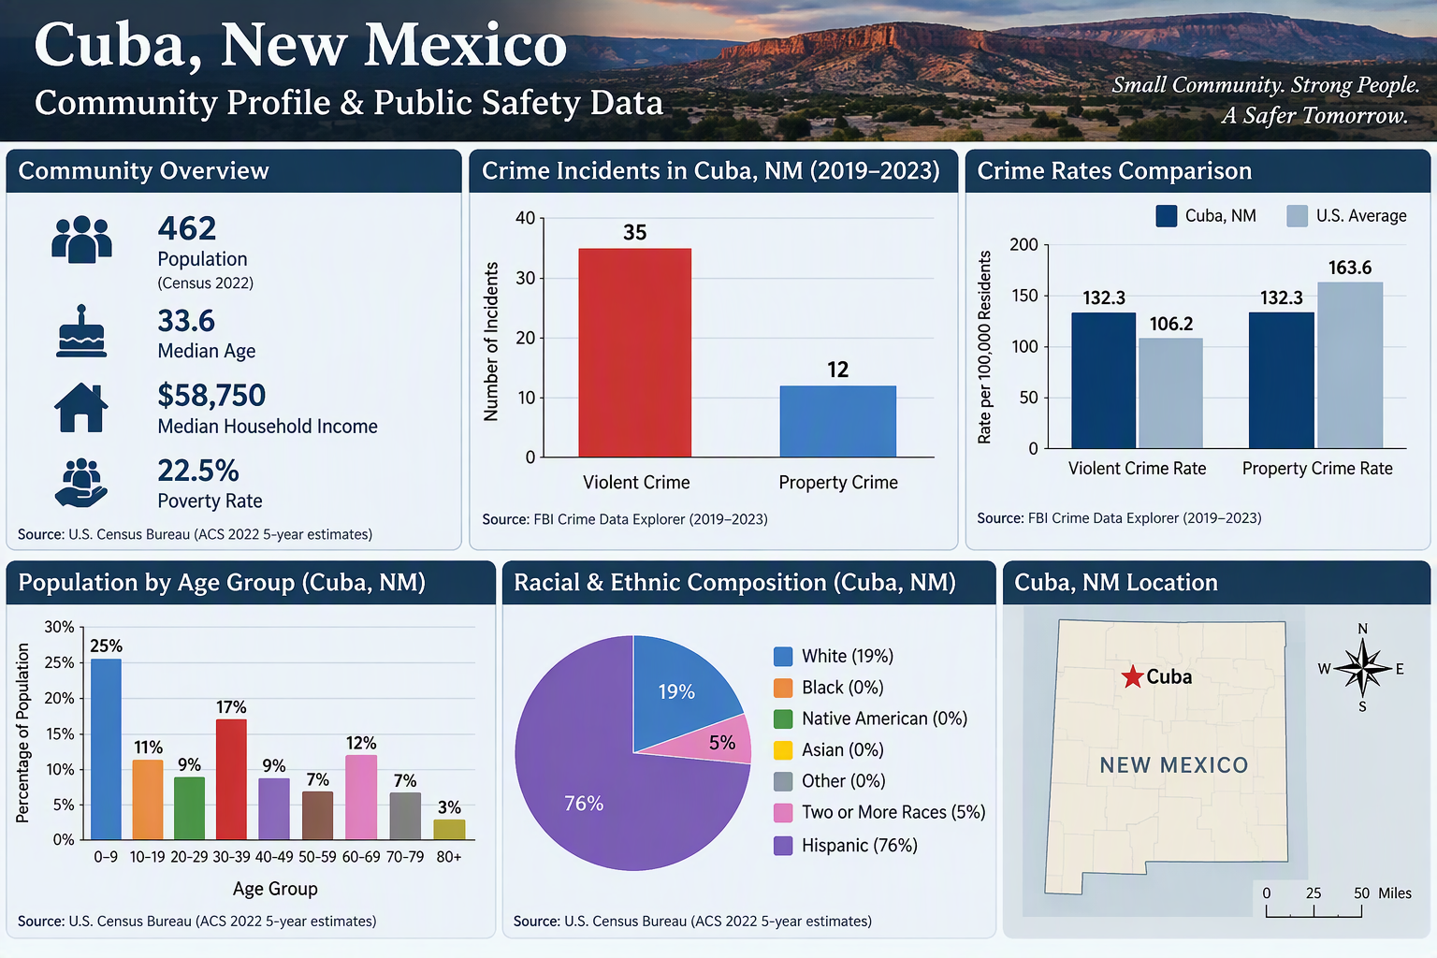
Safety, Security, and Violence in Cuba, New Mexico
A Data-Driven Community Safety Analysis
Safety & Crime Statistics
Total Violent Crimes (2019-2023): | 35 incidents
Total Property Crimes (2019-2023): | 12 incidents
Violent Crime Rate: | 132.3 per 100,000 residents
Property Crime Rate: | 132.3 per 100,000 residents
Most Common Violent Crime: | Aggravated Assault
Community Overview
Population: | 462 residents
Median Age: | 33.6 years
Median Household Income: | $58,750
Poverty Rate: | 22.5%
Violence Analysis
Violent Crimes: | 35 Incidents
Property Crime: | 12 Incidents
Aggravated Assault: | 23 incidents
Burglary: | 6 incidents
Comparison to U.S. Average
Crime Type | Cuba, NM | U.S. Average
Violent Crime Rate | 132.3 | 106.2
Property Crime Rate | 132.3 | 163.6
Understanding patterns in crime, violence, and community demographics can help local leaders, residents, and organizations make informed decisions that improve public safety and community well-being in Cuba, New Mexico.

